Slide 1

Revolution art
Team 1

Slide 2
Meet the team
Project Manager: Zo DiSanto
Project Owner: Melika Zandikarimi
Business Analyst: Jianan Jiang
Lead Developer: Shanshan Li
Developer: Kishore Kanchan
Lead DBA: Rufan Mirganiyev
QA Analyst & Tester: Louise Ngo

Slide 3
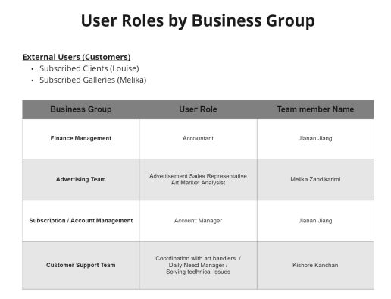
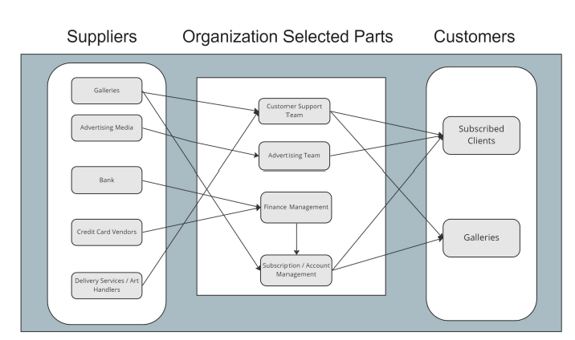
BRM

Slide 4
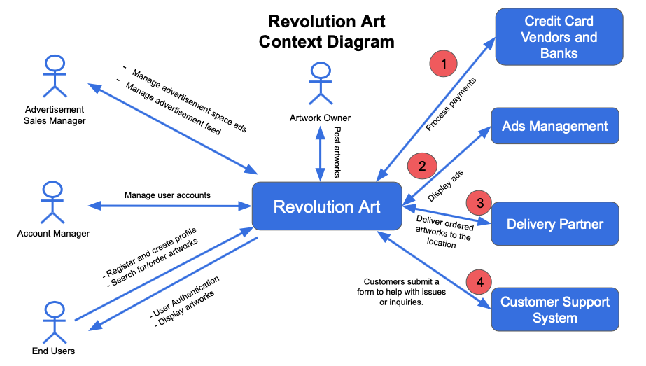
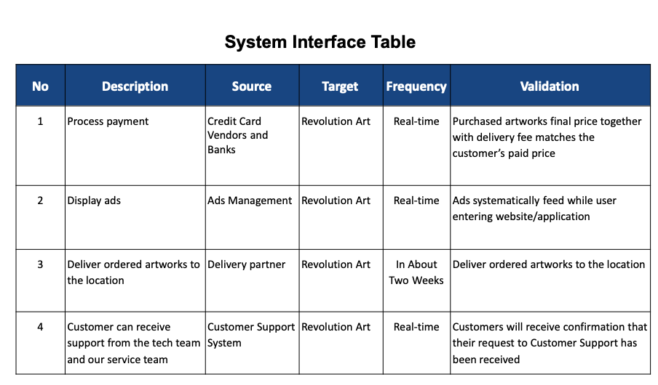
Context Diagram

Slide 5
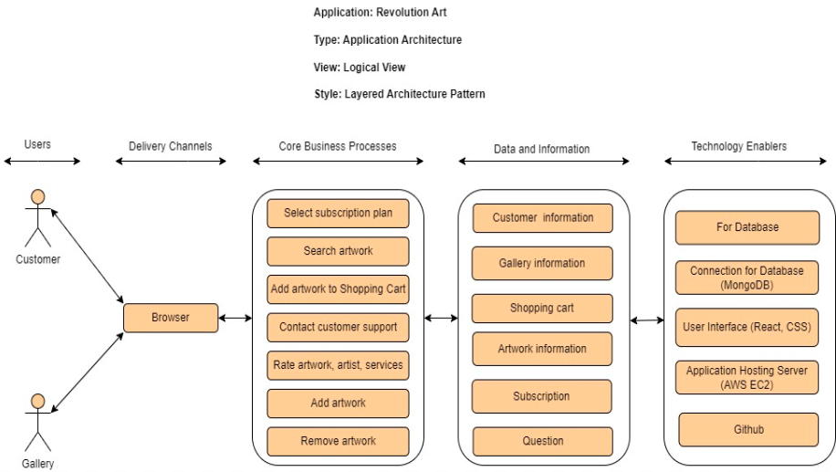
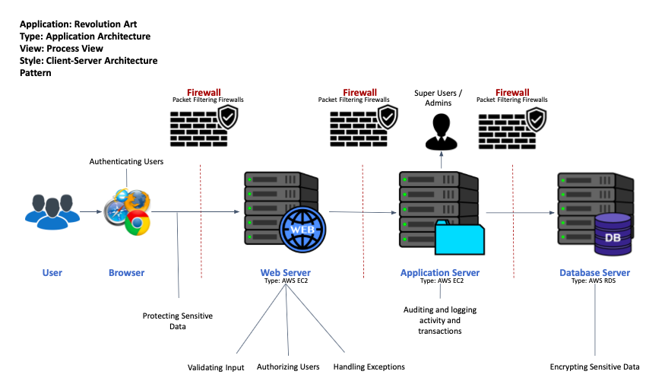
Architecture Diagram

Slide 6
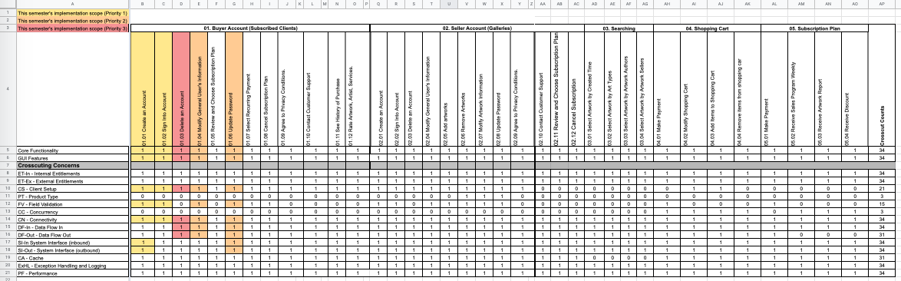
RCT

Slide 7
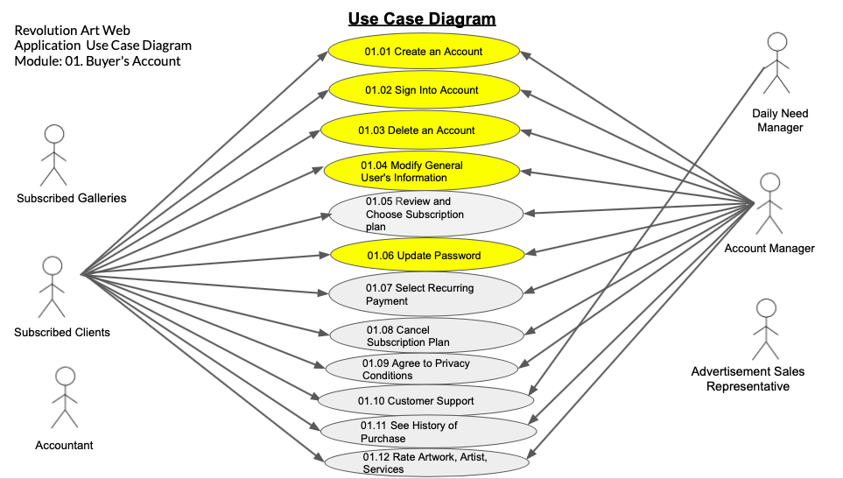
Use Case Diagram

Slide 8
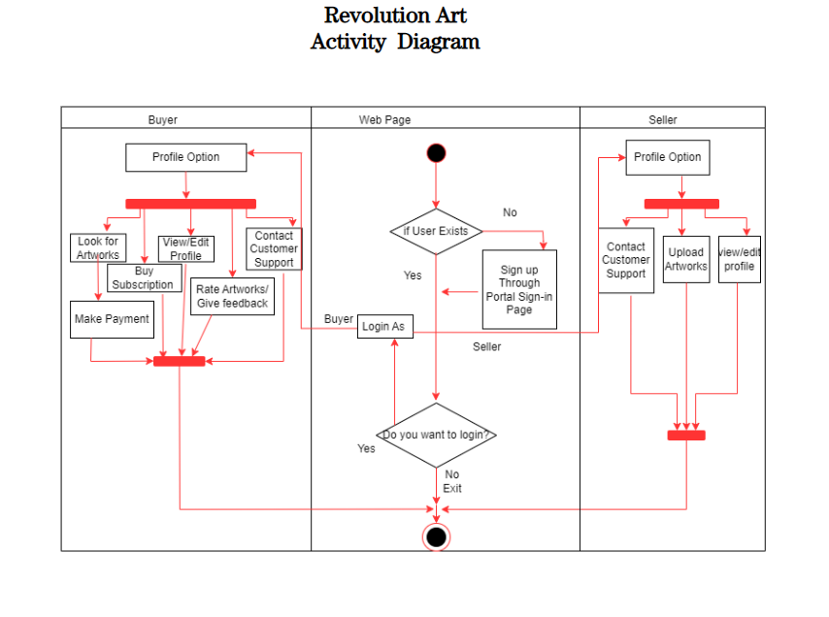
Activity Diagram

Slide 9
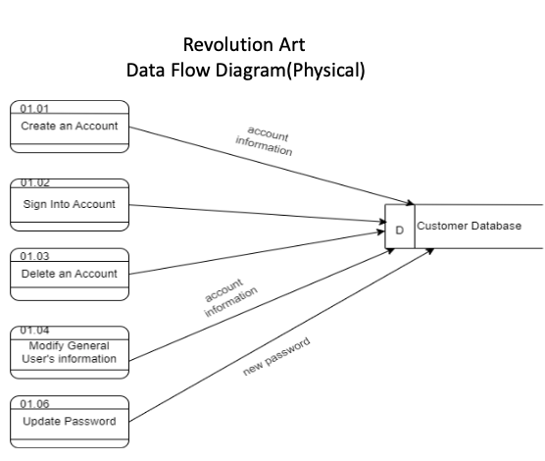
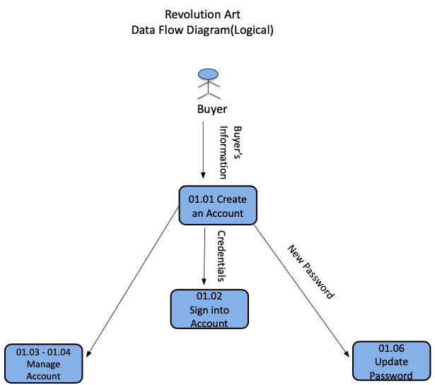
Data Feed Diagrams (Logical & Physical)

Slide 10
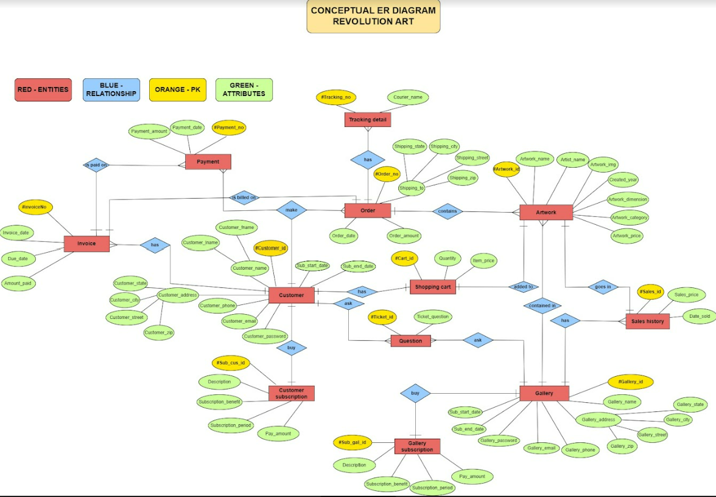
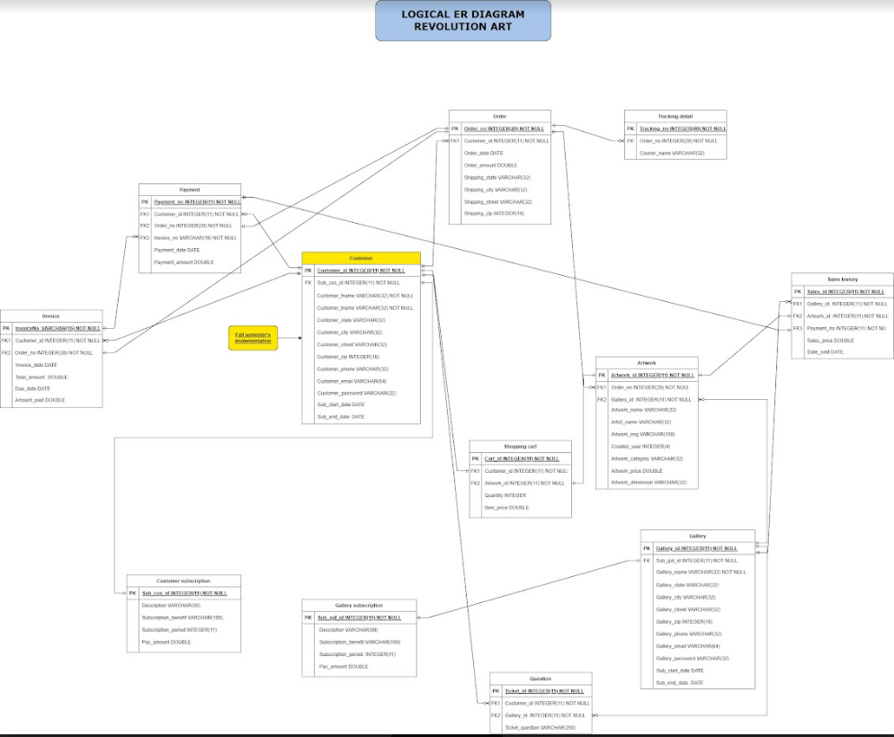
ER Diagrams

Slide 11
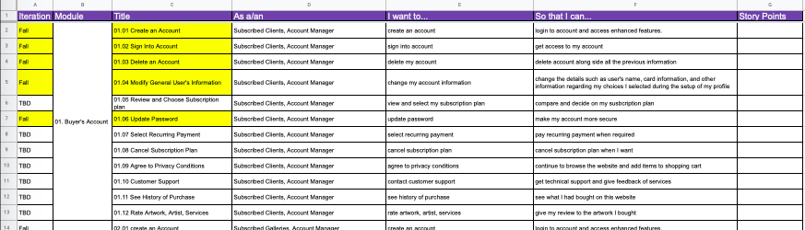
Functional Specs (User Stories)

Slide 12
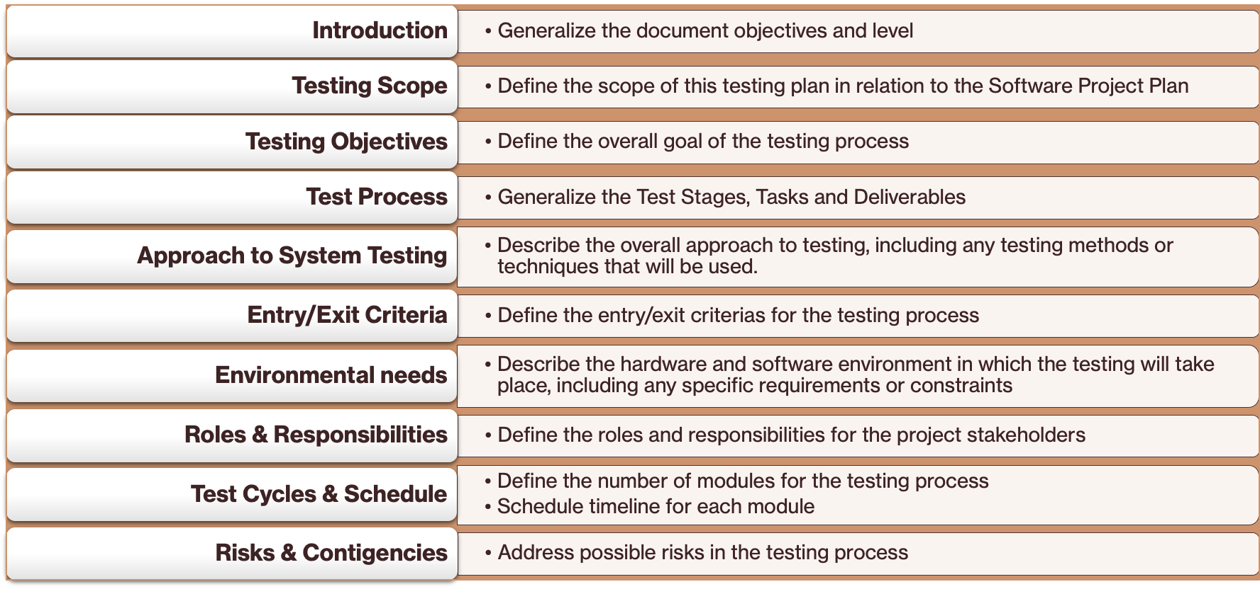
Test PLan

Slide 13
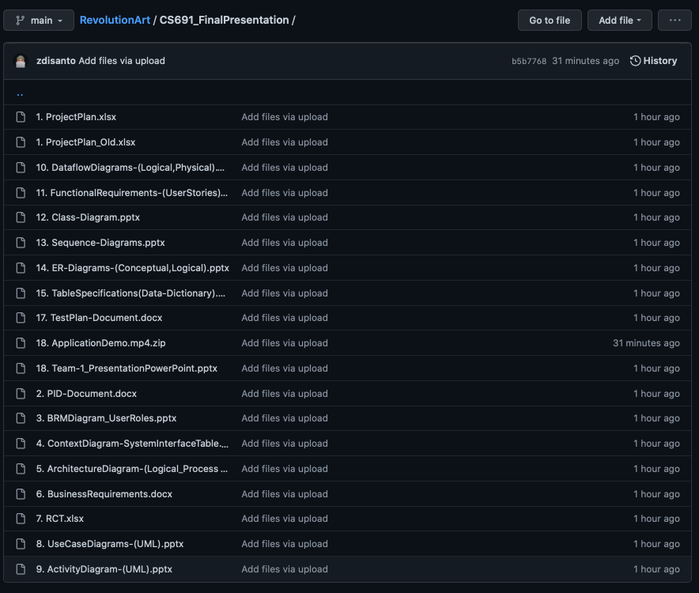
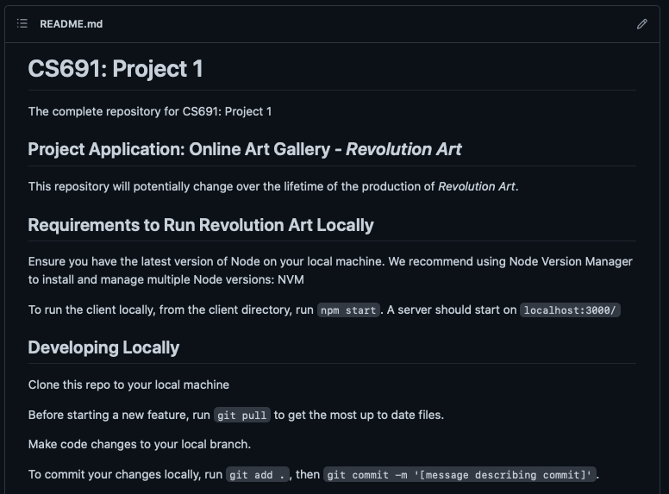
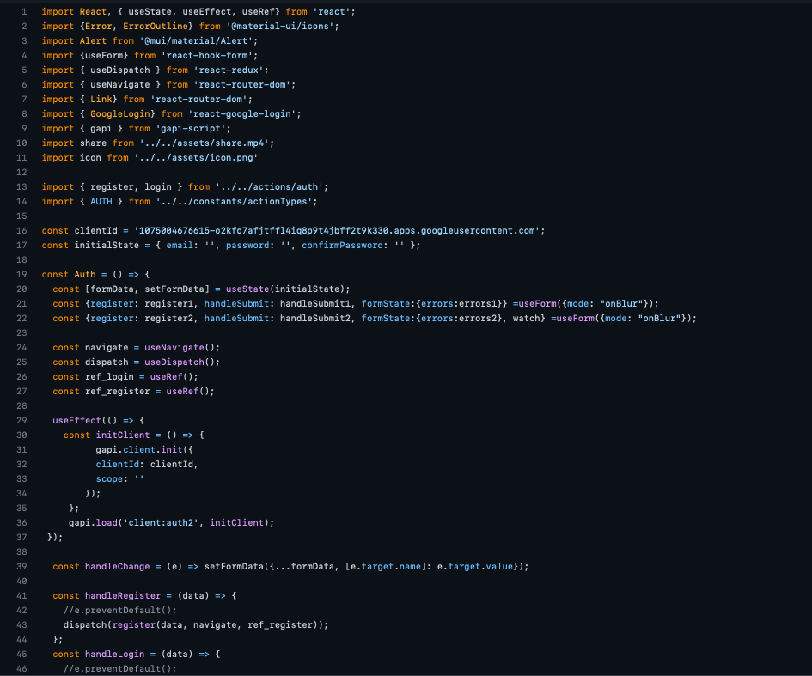
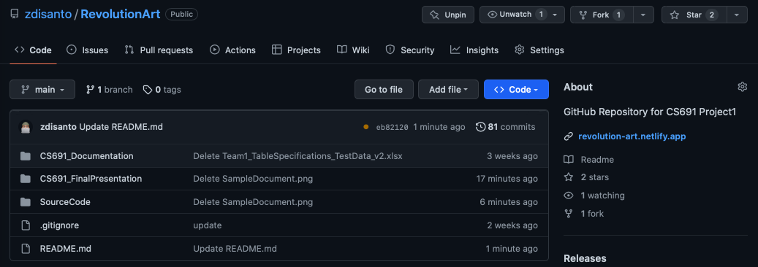
Github

Slide 14
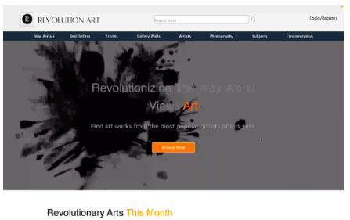
Application Demo
Video found in ZIP file

